Slide 1
Quality Stream – Change Management
Technology Unified Process
Feb 2012

Slide 2

Objective
Apply a unified process to govern the change management activities including all the Technology services and focusing on achieve successful implementation of changes from first attempt and minimize the impact of change related incidents on service quality
The process is meant to deliver an appropriate response to change requests maintaining a proper balance between the need for Change against the impact of the Change.

Slide 3

Goal & Scope
Goal
Respond to the customer’s requirements for services, systems and applications changes while maximizing value and reducing incidents, disruption and re-work
Scope
This process is used in all cases of technical changes to production hardware and software systems including
New services/systems roll out
Patch deployment
System upgrades
Software new releases
Hardware upgrades & maintenance
Software fixes and updates
New feature deployments
Incident and problem management related changes

Slide 4
Process Key Points
A unified change management process across Technology
A unified system for changes processing “ Remedy”
A dedicated team/function to process change requests and own the change management process
A Technology committee of all Technology teams SPOCs and stakeholders meeting weekly to approve major changes and review implemented changes results
A daily operational alignment meeting for operations teams to discuss changes planned for the day
Pre and post implementation testing for changes is mandatory
Technical evaluation for changes by requesting and implementing teams

Slide 5
Process Key Points (cont.)
Roll back plan is mandatory for change processing
A simple workflow for simple changes, an expedited workflow for urgent changes
Change Management process KPI reports to Technology management
Change requests and related incidents are linked on Remedy system
A planned changes schedule is published to Technology dept.
An SLA/OLA between Change Management and Technology teams to define and agree on change requests processing timelines

Slide 6
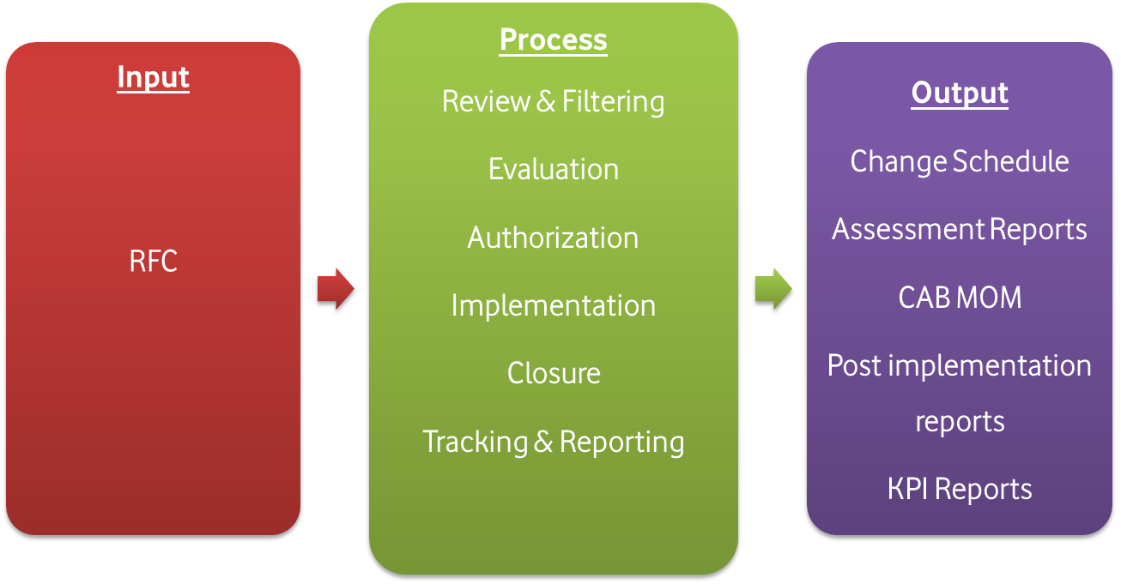
Change Management Process

Slide 7
Change Request Phases
Initiation
Review & Evaluation
Authorization
Implementation
Closure
Change requester submits a CR on Remedy Requester’s manager evaluate the CR and confirms it is technically valid CR goes to CM | CM review CR and ensure it satisfies mandatory requirements CM evaluates CR classification, Urgency , Impact and Risk levels Implementer evaluates and validates request | CAB meeting for Normal changes Pre- approval automated workflow for standard changes ECAB of Senior Mgt level over a conference call for Emergency changes | Change steps assigned to implementation team through Remedy tasks Implementer updates the status of implementation on Remedy Post implementation testing shall be conducted by a separate unit than the implementer whenever possible | Change requester evaluates implementation report to declare change success/failure

Slide 8
Changes Classification
The process defines three classes of changes to balance business agility and changes control, with a simple workflow for simple changes and an expedited workflow for emergencies
 | Limited scope, low risk and high frequency Can be implemented without disrupting the business operation Pre-approved by CM and CAB Only requester and implementer managers approval is required
 | Intended to repair an error in a service that is impacting the business May be used for strategic commercial new services launch Approval by ECAB (CM, Requester & Implementer Senior Managers) Could be logged to Remedy after implementation
 | Non standard or Emergency change Approval through CAB Well planned and evaluated change
Standard Change
Emergency Change
Normal Change

Slide 9
Change Prioritization
Change priority determine the relative importance of a Change
Impact | Description
Extensive | Impacts > 25% of subscribers Impacts > 1% of VAS customer base Impacts > 100 sites Risk revenue > EGP 250K Impacts multiple services/systems or departments Impacts a “Mission critical” service
Significant | Impacts > 15% of subscribers Impacts > 0.5% of VAS customer base Impacts > 50 sites Risk revenue > EGP 51K Affecting a complete business unit Impacts a “Business critical” service
Moderate | Impacts > 10% of subscribers Impacts < 0.5% of VAS customer base Risk revenue > EGP 1K Impacts > 10 sites Affecting a small number of individuals Impacts a “Business important” service
Minor | no impact on operational services
Urgency | Description
Critical | Needs to be implemented quickly to recover an unavailable service or to deploy a commercial strategic roll out
High | Needs to be implemented quickly to recover certain functions of a service
Medium | Needs to be implemented within an appropriate time frame to recover a service that is not severely impacted
Low | Needs to be implemented within an appropriate time frame to recover certain service functions that are degraded but still available
Priority = Impact X Urgency
Priority | Description
Critical | Immediate action required, ECAB authorization, resources allocated immediately in < 12 hours
High | Accepting business and technical risks , CAB/ECAB authorization , resources allocated immediately in < 24 hours
Medium | Scheduling is required to ensure coordination between groups, management commitment of resources, CAB
Low | The Change is made available for review to ensure general awareness and alignment

Slide 10

Risk Assessment
Change risk assessment should be conducted by the change management team to identify the level of risk associated with the requested change
Risk level | Description
Level 1 | No service impact
Level 2 | Low impact, Low probability
Level 3 | Low impact, High probability
Level 4 | High impact, Low probability
Level 5 | High impact, High probability

Slide 11

Change Authorization
CAB committee
The Change Advisory Board (CAB) is a body that supports the authorization of Extensive and Significant changes, prioritization, review of changes and review of changes that were implemented through a periodic weekly meeting
CAB main objectives:
Review all proposed RFC with Extensive and Significant impact
Approve the change proposed implementation date and time
Ensure minimizing/eliminating the Change impact on business services
Ensure the proposed change does no t impact any committed service SLA
Review post-implementation reports of implemented changes
Review and approve the weekly change schedule
CAB includes: CM, Tech-IM, TSD, Help Desk, VIS Service Desk, Technology ,Service Level MGT, IT O&S teams managers, Net Ops teams managers, Access Network teams managers, Relevant P&S, Relevant Business team representative, Any participant the change manager finds necessary according to the change nature

Slide 12

Change Authorization
ECAB committee
Emergency CAB (ECAB) is a small form of Change Advisory Board who makes authorization decisions for Emergency Changes where the committee members are of higher level of organizational authority than the regular CAB committee members and are only relevant to the service in scope of the proposed Emergency change.
ECAB meetings are ad-hoc meetings that could be in the form of conference call chaired by the change management and includes the change requester, implementation groups management, requester team management to negotiate all change aspects such as risk of not implementing the change, business impact date/time, implementation plan, rollback plan, and change approvals.
ECAB includes: CM, Requester & Implementer Senior Management

Slide 13
Change Implementation
The implantation team who previously validated the change will receive a task from Remedy system with the change details and the approval of the implementation team manager confirms that the change is technically evaluated and valid for implementation.
Change is implemented as per approved schedule and update the status on Remedy system.
For changes with several technical implementation teams the change manger has the role of co-coordinating the implementation activities as well as acting as SPOC to business and management teams for change updates during the implementation stages.

Slide 14
Change Closure
On completion of the change, the post- implementation tests are assessed by the change requester upon which the change is either closed or updated for a second trial .
The post- implementation tests results, change closure status and any incidents occurred due to the change are reported to the CAB in the next scheduled meeting.

Slide 15
Change MGT & Incidents
To enable analysis of changes quality and identify incidents resulting from planned changes , all incidents is resulting of a change implemented prior to the incident should be linked to the change request record on the Remedy system through the “Relationship” option that will be introduced upon new Remedy version roll out.
As well as changes requests initiated to resolve an incident or resulting of problem management analysis to eliminate a fault root cause should be linked to the incident record on the Remedy system .
The Technology operations teams shall have a daily meeting in which all changes planned for the day are discussed in order to ensure operational alignment and avoid any conflicts in changes implementation activities that may result in unpredictable results

Slide 16

Change MGT & Service Transition
New system/services transitioning from development, pilot & pre-production to production operational state will go through the change management process to ensure full awareness of all the concerned parties and maintain the system/service roll out records for tracking and analysis
Systems and services retirement and decommissioning will go through change management process, to ensure all the stakeholders are informed and any necessary controls are maintained

Slide 17

Tracking & Reporting
The change management team shall measure and report the below process KPIs:
Number of changes which met the customer’s agreed requirements
Average time to implement a change based on urgency/priority/change type
Number of incidents attributable to changes
Number of planned vs. unplanned changes (Emergency changes)
Number of failed changes
Frequency of change (by service, business area, etc.)
The number and percentage of Changes rolled back successfully/unsuccessfully
Number of changes with no pre-implementation testing

Slide 18
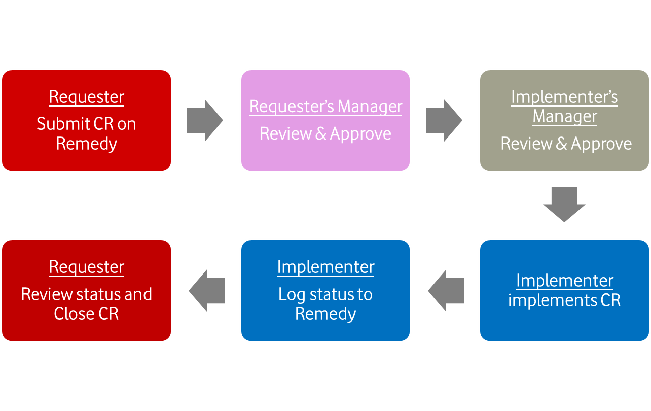
Workflows – Standard Change

Slide 19
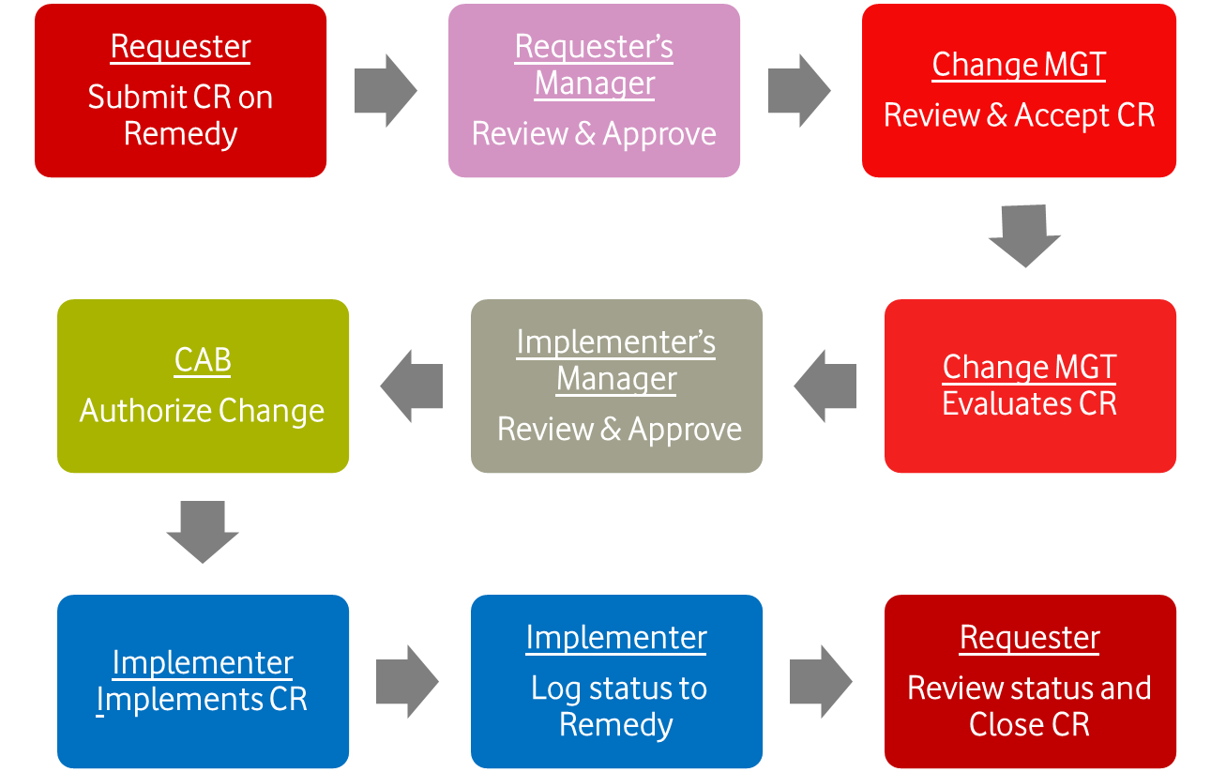
Workflows – Normal Change

Slide 20
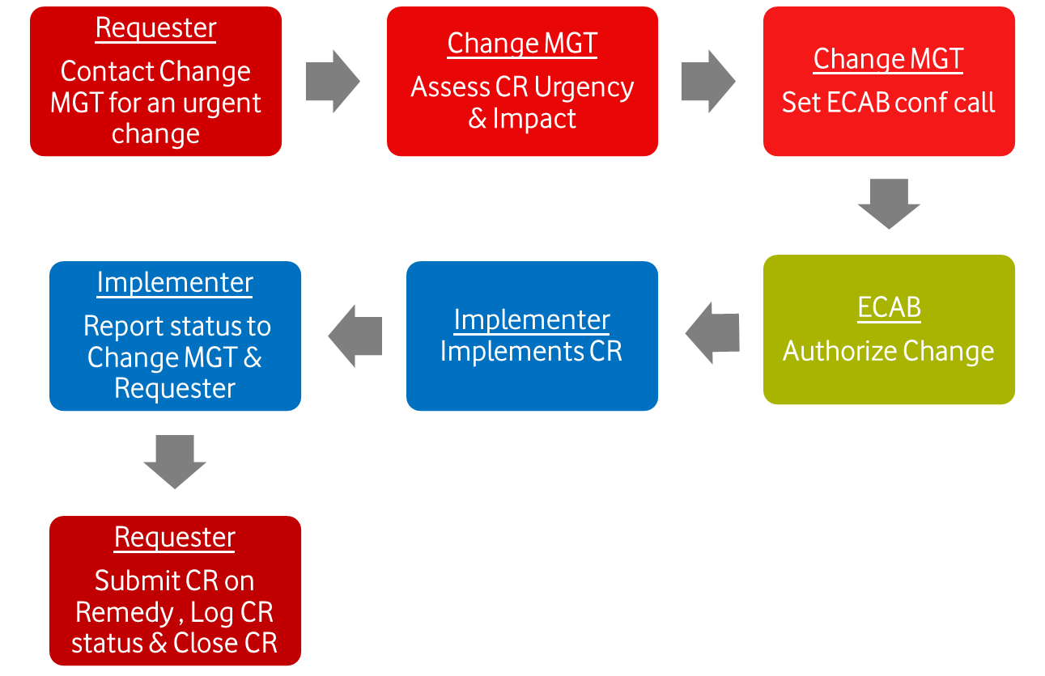
Workflows – Emergency Change

